Slide 1
Submittable
Instruction Manual 2020

Slide 2
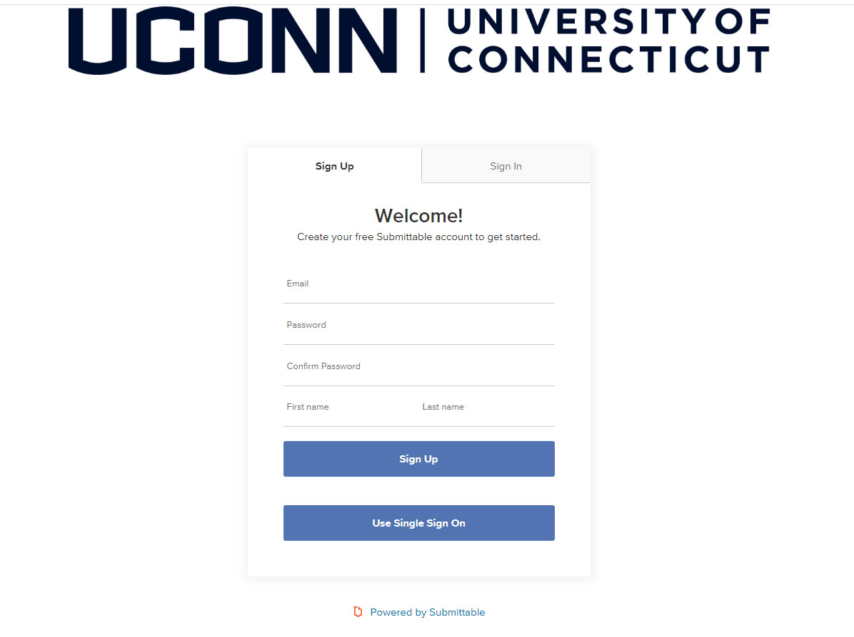
Create an account
Students can create a new account at https://uconn.submittable.com/login
Always use your uconn.edu email account
And sign in using the
Single Sign On button

Slide 3
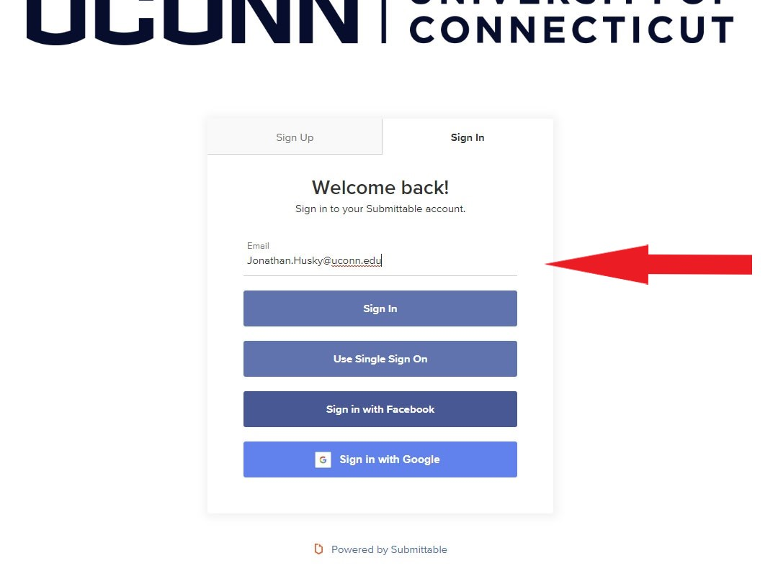
When returning, login in with your uconn.edu email and click the “use Single Sign On” button. Use of the UConn Single sign on, requiring your NetID and password will allow you to be authenticated and directed to the correct location for submission, resubmission or review.

Slide 4
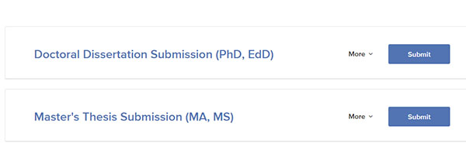
Click on the appropriate link for your submission.

Slide 5
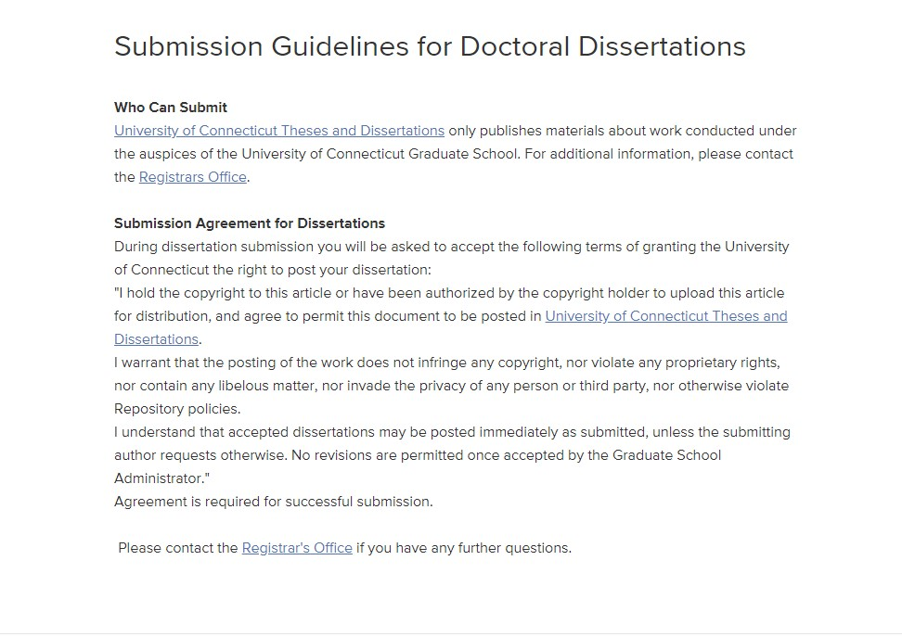
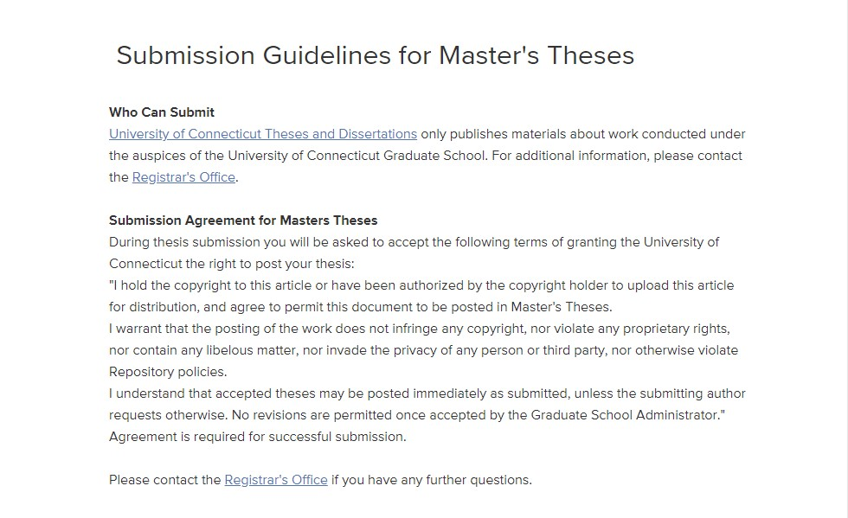
Guidelines for Submission
Guidelines for Thesis submission
Guidelines for Dissertation submission

Slide 6
Follow the Instructions for submission
Have the required information available and complete the submission form
Thesis Dissertation
1. Full text of your thesis in Word or PDF format
2. Abstract (optional)
3. Supplementary Files (images, sound, etc.) that are an integral part of the thesis, but not part of the full text.
4. Major and Associate Advisors Name(s).
5. Field of Study. You must choose from the supplied list.
6. Keywords (optional)
1. Full text of your dissertation in Word or PDF format.
2. Abstract
3. Supplementary Files (images, sound, etc.) that are an integral part of the dissertations, but not part of the full text.
4. Major and Associate Advisors Name(s).
5. Field of Study. You must choose from the supplied list.
6. Keywords (optional, but recommended)

Slide 7
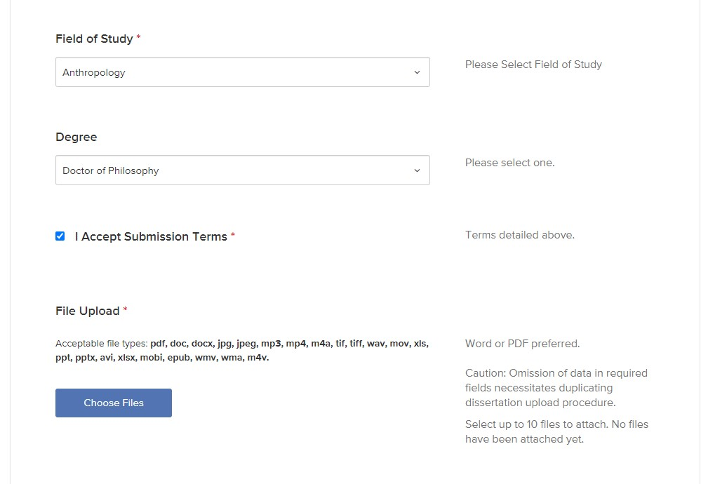
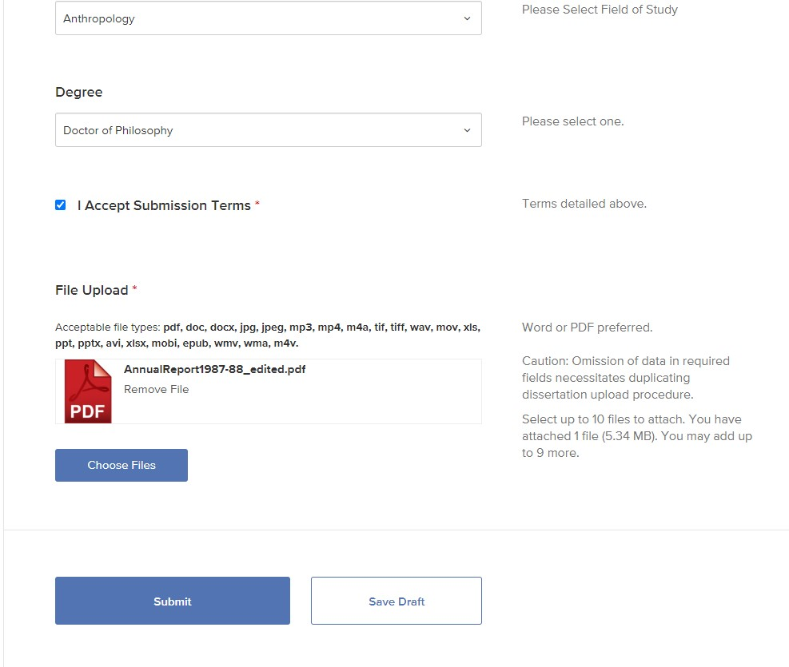
Complete the form
Icon will appear to indicate successful upload. Use “Choose Files” button to add supplementary materials. Click “Submit” when finished.
Be sure to check the I Accept Submission Terms button

Slide 8
You will receive an email confirming your submission.
Staff will review your submission and respond by email to inform you of
  Congratulations on a successful submission, or
  Corrections that need to be made
  If you haven’t received an email confirmation or other communication within two days of your submission, remember to check your SPAM folder before contacting the Degree Audit Office.

Slide 9
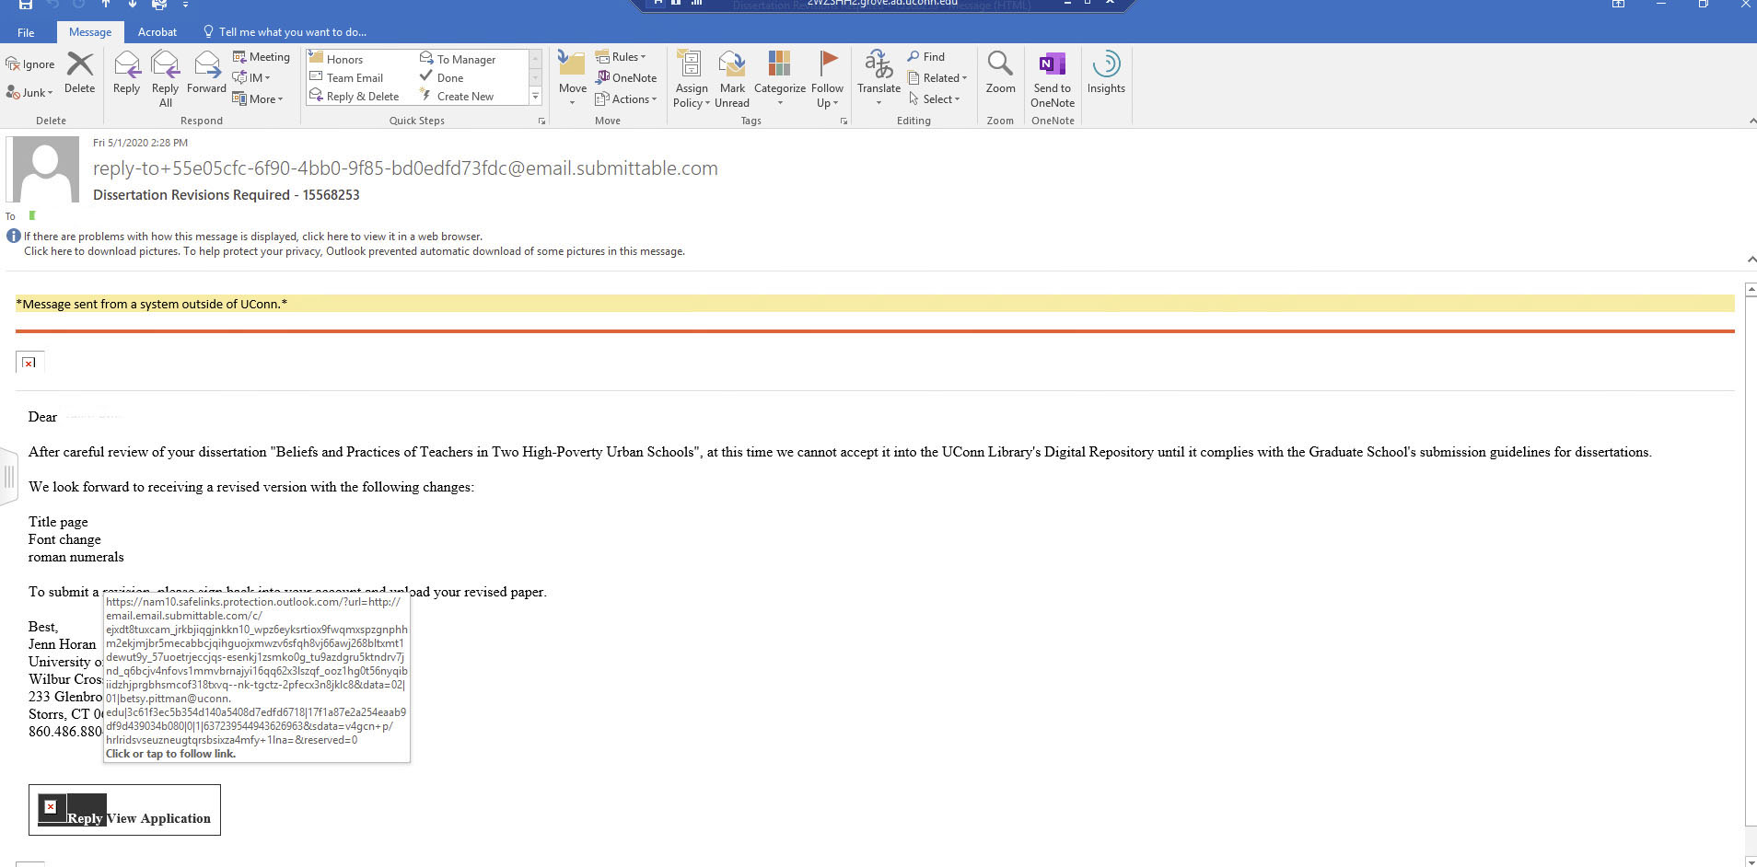
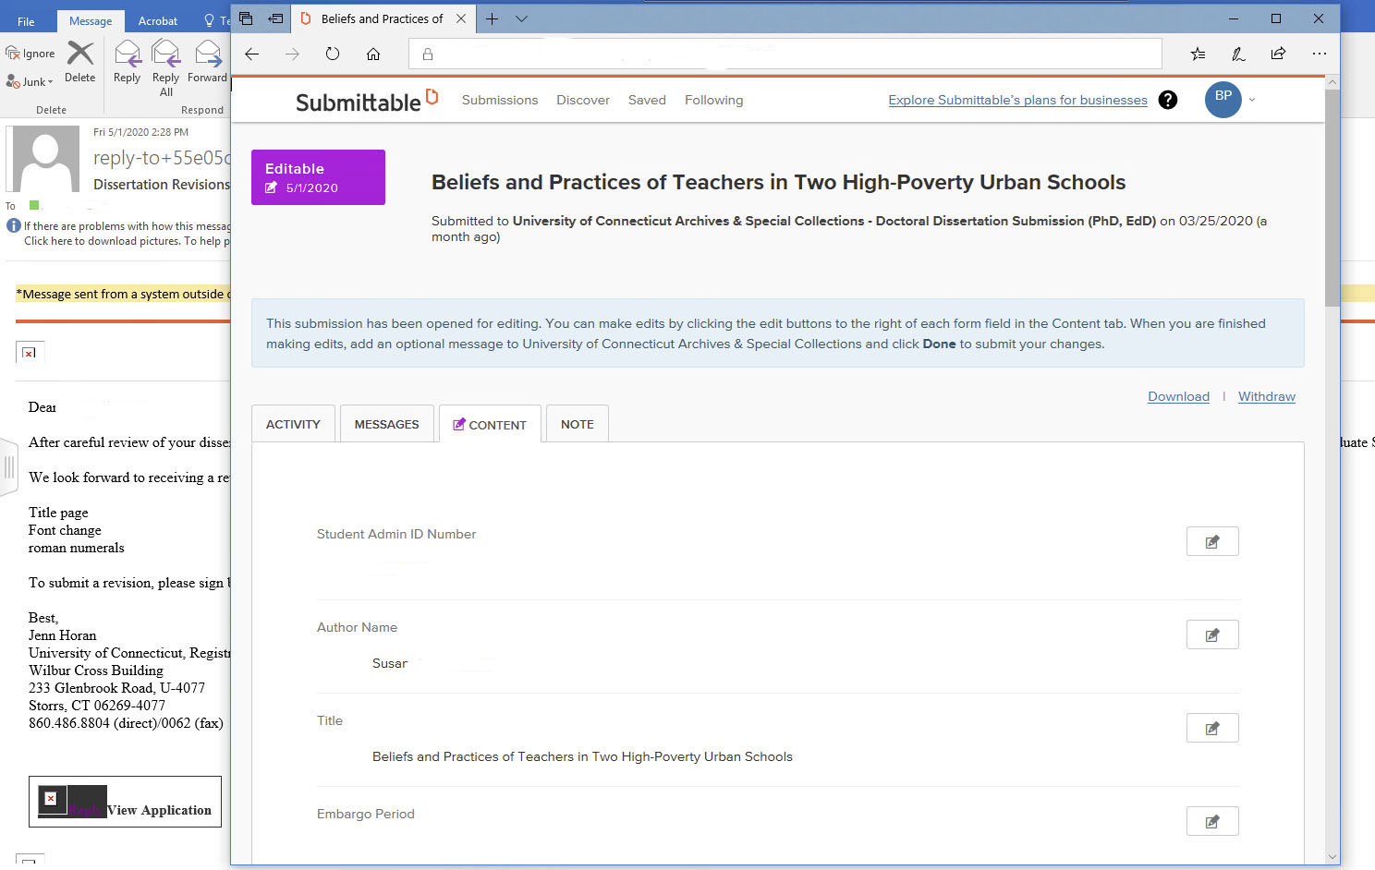
Revisions needed
The email detailing necessary revisions will have a link in the lower left corner which will direct you to your submission, once you have logged in with your uconn.edu email.
Your original submission will be open for editing. Make the requested changes and resubmit.

Slide 10
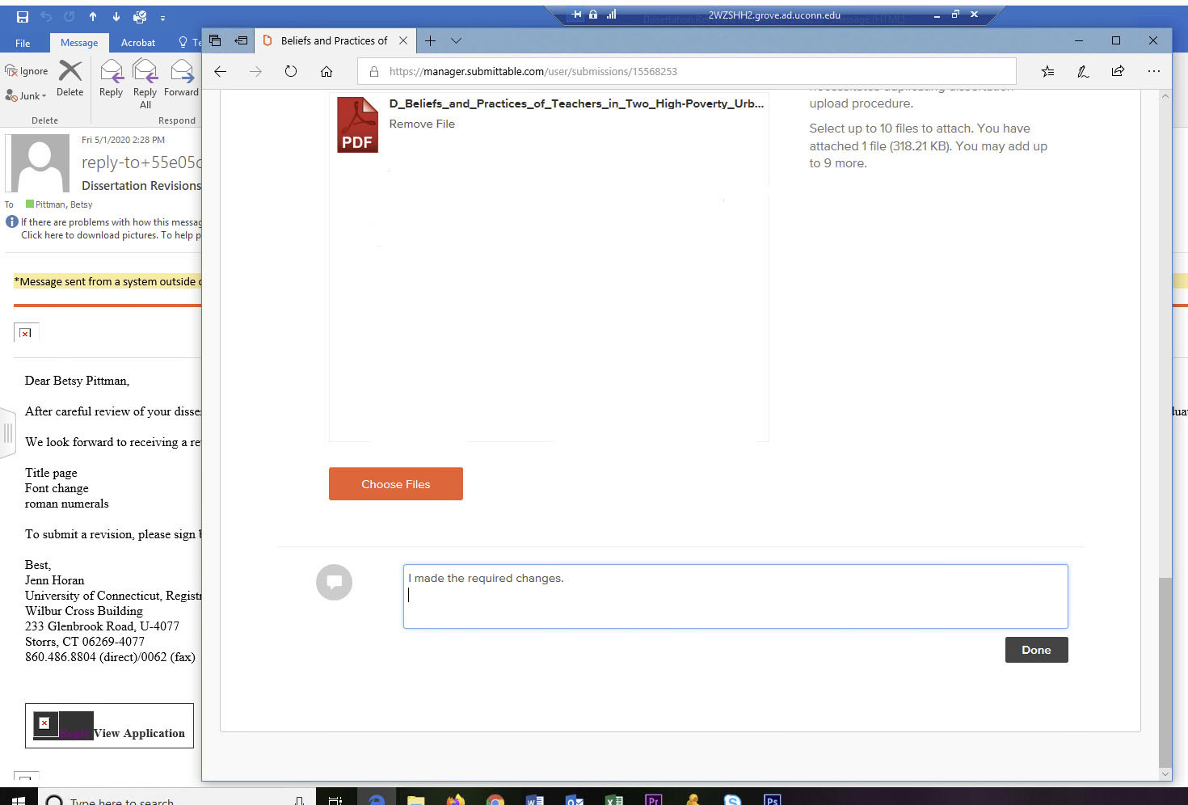
Your revised submission has been successfully uploaded when the PDF icon appears.
Once your revised paper has been uploaded, click the “Done” button to resubmit.

Slide 11
You will receive an email confirming your resubmission.
Staff will review your submission and respond by email to inform you of
  Congratulations on a successful submission

Slide 12
Submittable instructions
May 2020
Archives & Special Collections, UConn Library

